Slide 1
AL Development
Bolzano, 23/10/2020
Stefano Primo, Developer Labs

Slide 2

Agenda
01
Nutritional Informations
Continuing the project
02
Translations
How to work with xlf files
03
Code Analysis
Why? How? But most importantly WHY?

Slide 3
Nutritional Informations
The customer ADM want to add an action on the Item List.
This action will show a summary page containing the sum of every nutritional information of every item.
Tip:
Use a temporary table to store all the informations (fat, protein,sugar…)
Calcsum?
Type | Total Amount | Additional infos.
Protein | 65950,5 | Sum of proteins for every item
Fat | 500 | Sum of Fats for every item
Sugars | 1000 | Sum of Sugars for every item

Slide 4
Nutritional Informations
When adding or modify a Nutritional Information for an item, show a message if the sum of calories is above 2000 (>2000).
Tip:
System Event or Trigger?

Slide 5
Nutritional Informations
When the Nutritional Information page is showed to the user, add a style to every row with this rule:
If the amount is < 10: StyleExpr: Normal
If the amount is > 10 and <100: StyleExpr: Favorable
If the amount is >100: StyleExpr: Attention
Tip:
Use the StyleExpr property on page fields
Ask for help

Slide 6
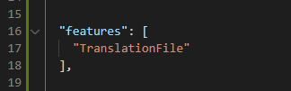
Translations
Setup:
In app.json add:

Slide 7

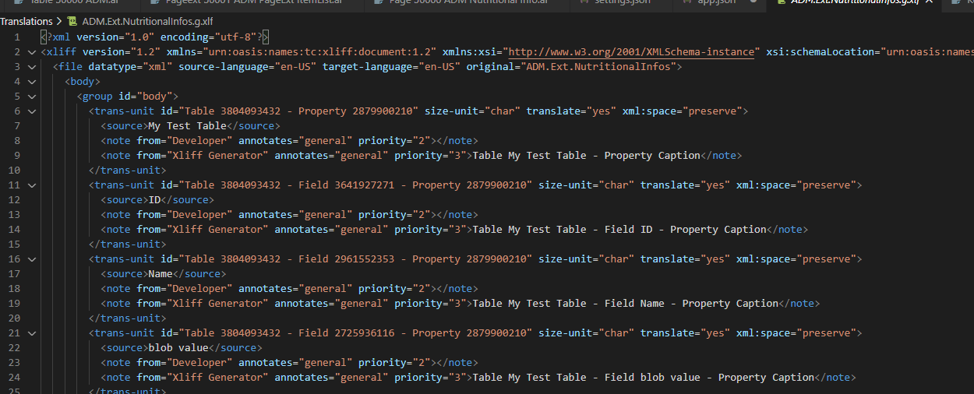
Translations
Usage:
After adding the feature in the app.json, build the app and it will create the *.g.xlf file:

Slide 8
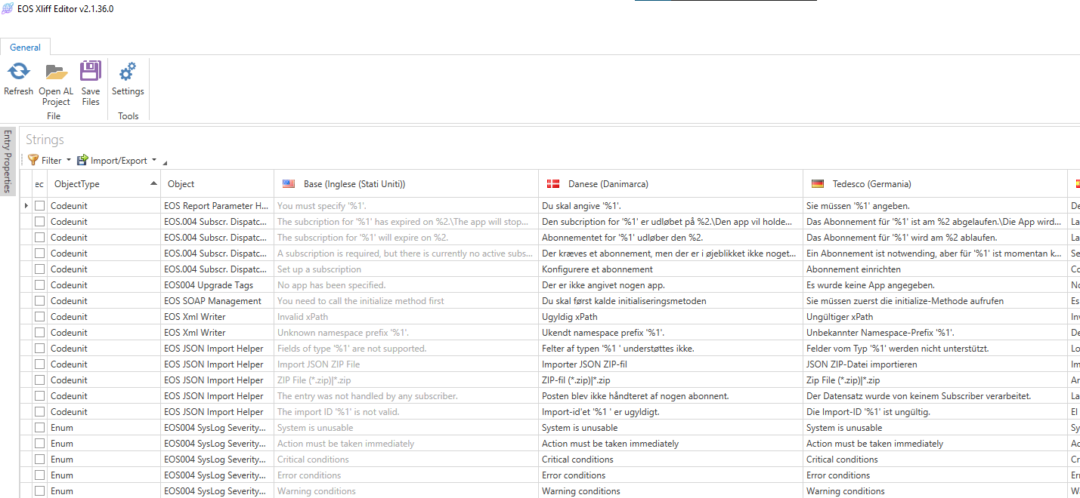
EOS XLF Editor

Slide 9
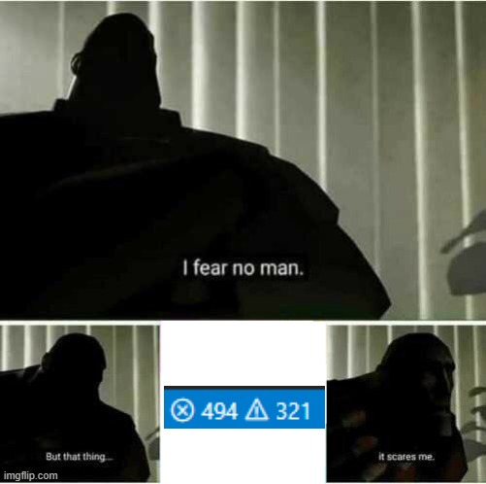
Code Analysis
Why?
With appsource and validation of every app, the code must have the same (or quite) conventions.
Performance Tips

Slide 10
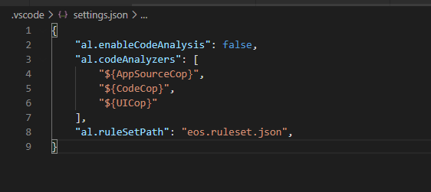
Code Analysis
How?
In the settings add the follow:

Slide 11



Grazie!

